Slide 1
Medicare: Custom Shoes & Orthotics
The shortest path to approval for you and your DIABETIC patients

Slide 2
What you’ll get today
Medicare coverage for diabetic footwear explained
How to make a referral for custom shoes and orthotics in the fewest possible steps
What physicians and treating professionals need to know
What patients need to know
Ways we support you and your patients’ health, as accredited Supplier
The need for custom shoes can be urgent
Foot health and mobility are directly tied to overall health

Slide 3
Our goal = decrease your frustration
Referring office paperwork requirements
Eliminate re-dos!
Patient responsibilities
Help them understand their part and get what they need ASAP
Good communications
Clarity about the referral process
Clarity for patients about how to break-in and take care of custom shoes and orthotics

Slide 4
Medicare Requirements
They’re picky but consistent

Slide 5
Althea’s Footwear Solutions bills Medicare
Medicare covers 80% of diabetic shoes and foot orthotics, including custom made
We bill secondary insurance for what Medicare doesn’t cover, when that applies
The patient is responsible for the balance
20% (less if they have secondary insurance)
Plus deductible's if they haven’t been met.
One pair of shoes and up to 3 pairs of foot orthotics per calendar year
Change orthotics up to every 4 months based on use
ALL CONTINGENT ON THE PAPERWORK ISSUED BY THE REFERRING MEDICAL TEAM

Slide 6
Three crucial documents
Prescription
Certificate of Medical Necessity (CMN)
Chart notes
MUST RESULT FROM A COMPREHENSIVE EXAM AS WELL AS A
FOOT EXAM BY THE ATTENDING MD OR DO

Slide 7
#1: Prescription
Must be the result of an examination of the feet by the Prescribing Practitioner, a physician from one of these disciplines
Doctor of Osteopathy (DO)
Medical Doctor (MD)
Podiatrist (DPM)
State that the patient is diabetic
Identify type of footwear required
Shoes
Inserts/orthotics
Text/order must be readable
Prescription for diabetic footwear expires after three (3) months
Must have both date written and start date of use of device on order

Slide 8
#2: Certificate of Medical Necessity
States the diabetic condition, Diabetes Mellitus
Type I
Type II
Correct ICD-10 diagnosis code
Verifies the qualifying medical condition for which shoes/orthotics are prescribed
History of previous foot ulceration
History of pre-ulcerative callus
Peripheral neuropathy WITH EVIDENCE OF CALLUS FORMATION (must have both)
Foot deformity
Poor foot circulation
History of partial or complete amputation of the foot or toes
CMN is complete when
Signed by the examining physician (in all places indicated) THIS MUST BE A MD OR DO
Office phone and fax provided
CMN expires after three (3) months

Slide 9
#3: Chart Notes
Detailed documentation of the patient’s diabetic care plan
All qualifying conditions checked on the CMN must be documented in the notes, for example:
Location of a foot ulcer
Type of foot amputation
Symptoms, signs or tests supporting diagnosis of peripheral neuropathy plus the presence of a callus
Specifics about poor circulation of the feet (venous or arterial insufficiency, diagnosis of related diseases, etc.)
Must be signed by the Certifying Physician in charge of the patient’s diabetes care (one of the following practitioners)
Doctor of Osteopathy (DO)
Medical Doctor (MD)
Chart Notes are valid for six (6) months

Slide 10
Referral support from us, your Supplier
Our staff is available to answer questions
We help patients with paperwork and information on what to get from their medical provider
We help referring medical professionals
Forms provided at our stores, on our website (altheas.com: Resources tab) and upon request
FOR MANY, CUSTOM FOOTWEAR IS LIFE-CHANGING AND
AN IMPORTANT PART OF IMPROVING OVERALL HEALTH

Slide 11
Our care and obligation for your patients
Comprehensive fitting and fabrication
Information
Billing
How to break in the new shoes/orthotics
Checking feet before and after footwear use
Footwear maintenance
Althea’s Footwear Solutions’ warranty
Supplements manufacturer’s warranty
Inserts change schedule (for those with orthotics)
Detailed brochure provided at time of footwear pick-up
Verbal review of all of the above
Proof of delivery

Slide 12
Medicare Coverage
Overview and demonstration project

Slide 13
Eligibility for therapeutic shoes for people with diabetes
SSA 1861(s)(12) describes coverage for, "extra-depth shoes with inserts or custom molded shoes with inserts for an individual with diabetes" when certain specified requirements are met. Reimbursement is available for shoes used by beneficiaries with diabetes when the applicable coverage requirements are met.
Suppliers (like Althea’s Footwear Solutions) are subject to Medicare audit and accountable for patient-specific documentation
Medical records: #1-#3
Required plans and signatures by the correct medical professionals
Documentation dated
Wear and care guide for footwear owner

Slide 14
Washington NOT part of Primary Care First Model Demonstration Project
January 1, 2021 – December 31, 2025
ONLY IN SELECTED AREAS
26 regions
Includes Alaska (statewide), Montana (statewide) and Oregon (statewide)
Nurse Practitioners can refer and certify Medicare beneficiaries for diabetic shoe and shoe insert benefits
Must bill “incident to” a physician’s services
ALTHEA’S FOOTWEAR SOLUTIONS WILL MONITOR THIS PROJECT AND INFORM REFERRING MEDICAL OFFICES IF/WHEN THIS CHANGE COMES TO WASHINGTON

Slide 15
Medicare detail drill-down
See the appendix of this presentation for references and related articles
Compiled by Althea Powell, C.Ped., L. Ped., O.S.T. (Florida Pedorthist and Supplier)

Slide 16
Part of your patient’s health team
Comprehensive personal fitting and fabrication

Slide 17
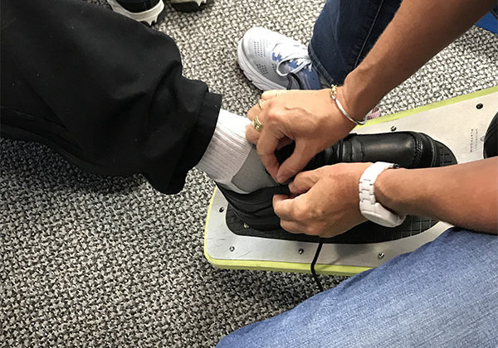
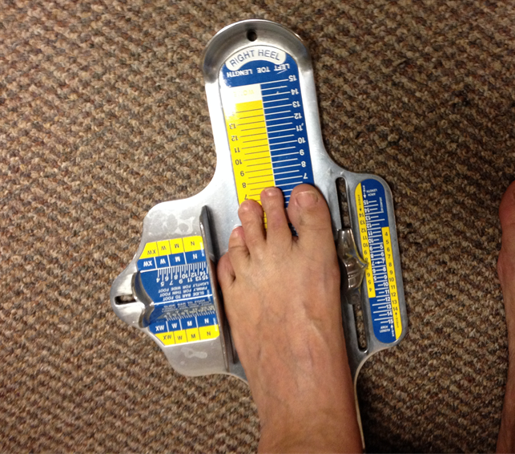
Althea’s Footwear Solutions
Full-service, accredited custom fabrication department
4 ABC Certified Pedorthists + 1 sitting for boards
Staff combine for more than 100 years of fitting stool experience
Serving diabetic and other unique feet

Slide 18
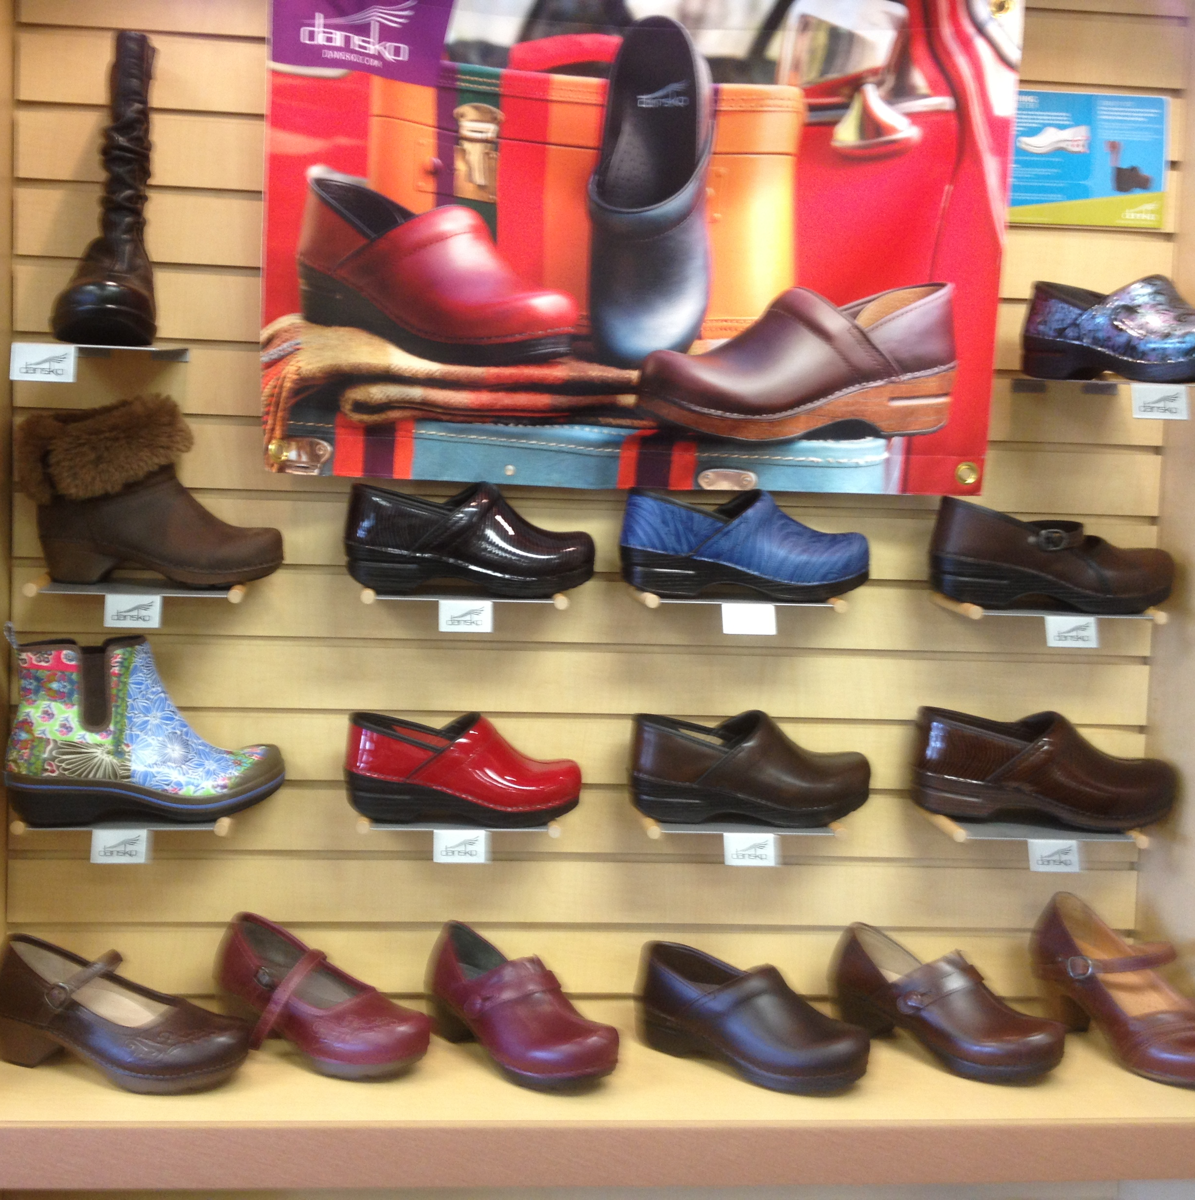
We take your comfort and foot health to heart
Two locations
Everett
425-303-0108
Lakewood
253-473-4311
Email
althea@altheas.net
Website
altheasfootwearsolutions.com
Range of styles to support a range of lifestyles

Slide 19
Thank you for taking time out today!
Watch your email Inbox for
Presentation (including the appendix)
Blank forms
Prescription
Certificate of Medical Necessity (CMN)

Slide 20
Appendix
Medicare details and article references

Slide 21
Patient eligibility for coverage of Therapeutic Shoes for Persons with Diabetes under Medicare
Medicare has limited coverage provisions for shoes used by beneficiaries. Section 1862(a)(8) of the Social Security Act (SSA) says:
No payment may be made under part A or part B for any expenses incurred for items or services … where such expenses are for orthopedic shoes or other supportive devices for the feet, other than shoes furnished pursuant to section 1861(s)(12).
SSA 1861(s)(12) describes coverage for, "extra-depth shoes with inserts or custom molded shoes with inserts for an individual with diabetes" when certain specified requirements are met. Reimbursement is available for shoes used by beneficiaries with diabetes when the applicable coverage requirements are met. The Therapeutic Shoes for Persons with Diabetes (TSD) Local Coverage Determination (LCD) and related Policy Article discuss these payment rules in detail.

Slide 22
Primary Care First Model Demonstration Project - Nurse Practitioners as Certifying Physicians for Therapeutic Shoes and Inserts
Joint DME MAC Article
Section 1115A of the Social Security Act established a new Center for Medicare and Medicaid Innovation (the Innovation Center) within the Centers for Medicare & Medicaid Services (CMS) to test new payment and service delivery models that have the potential to reduce Medicare, Medicaid, and Children's Health Insurance Program expenditures while maintaining or improving the quality of care for beneficiaries. In addition to special payment provisions for primary care services, there are special waivers under the model that allow for payment of other Medicare benefits under conditions that would not otherwise be paid for. When claims are paid under these special "waived" conditions, the claims are also to be tagged with the demonstration code.

Slide 23
Effective January 1, 2021 and extending through December 31, 2025, CMS is exercising its authority under the Primary Care First (PCF) model to waive Section 1861(s)(12) of the Act and the implementing regulations at 42 CFR 410.12 to allow nurse practitioners to certify that an order for diabetic shoes is required according to Section 1861(s)(12). Under this waiver authority, beneficiaries with diabetes are eligible for the standard Medicare diabetic shoe and shoe inserts benefit if a nurse practitioner refers or certifies the beneficiary. Normally, these items are only paid under traditional Medicare Fee-For-Service (FFS) if a physician (MD or DO) refers or certifies the beneficiary

Slide 24
.
The model is not changing the benefit coverage or limits in any way other than that of loosening the requirement for the referring or certifying provider to include nurse practitioners as well as physicians. Volume limits on supplies, any requirements regarding who can bill for the shoes and supplies, and any other edits that may be applicable to current FFS claims processing for these items shall not change under the model. The Center for Medicare and Medicaid Innovation will launch the PCF model in 26 regions: Alaska (statewide), Arkansas (statewide), California (statewide), Colorado (statewide), Delaware (statewide), Florida (statewide), Greater Buffalo region (New York), Greater Kansas City region (Kansas and Missouri), Greater Philadelphia region (Pennsylvania), Hawaii (statewide), Louisiana (statewide), Maine (statewide), Massachusetts (statewide), Michigan (statewide), Montana (statewide), Nebraska (statewide), New Hampshire (statewide), New Jersey (statewide), North Dakota (statewide), North Hudson-Capital region (New York), Ohio and Northern Kentucky region (statewide in Ohio and partial state in Kentucky), Oklahoma (statewide), Oregon (statewide), Rhode Island (statewide), Tennessee (statewide), and Virginia (statewide). Additional information on the PCF model may be found here: https://innovation.cms.gov/innovation-models/primary-care-first-model-options

Slide 25
Suppliers servicing beneficiaries in the 26 model demonstration regions should be alert to this information to ensure that documentation from nurse practitioners serving as certifying physicians for therapeutic shoes and inserts are participating in the PCF demonstration project. Only nurse practitioners participating in the PCF demonstration or are billing "incident to" a physician's services are eligible to serve as the certifying physician for therapeutic shoes and shoe inserts. For additional information on nurse practitioners billing "incident to" see the article titled Nurse Practitioners and Physician Assistants as Certifying Physicians for Therapeutic Shoes and Inserts.

Slide 26
Role of DPM,MD, DO, Pedorthist
The Certifying Physician is defined as a doctor of medicine (M.D.) or a doctor of osteopathy (D.O.) who is responsible for diagnosing and treating the beneficiary’s diabetic systemic condition through a comprehensive plan of care. The certifying physician may not be a podiatrist, physician assistant, nurse practitioner, or clinical nurse specialist. The Prescribing Practitioner is the person who actually writes the order for the therapeutic shoe, modifications and inserts. This practitioner must be knowledgeable in the fitting of diabetic shoes and inserts. The prescribing practitioner may be a podiatrist, M.D., D.O., physician assistant, nurse practitioner, or clinical nurse specialist. The prescribing practitioner may be the supplier (i.e., the one who furnishes the footwear). The Supplier is the person or entity that actually furnishes the shoe, modification, and/or insert to the beneficiary and that bills Medicare. The supplier may be a podiatrist, pedorthist, orthotist, prosthetist or other qualified individual. The Prescribing Practitioner may be the supplier. The Certifying Physician may only be the supplier if the certifying physician is practicing in a defined rural area or a defined health professional.

Slide 27
THERAPEUTIC SHOES FOR DIABETICS: PHYSICIAN DOCUMENTATION REQUIREMENTS
Dear Physician:
Medicare covers therapeutic shoes and inserts for persons with diabetes. This statutory benefit is limited to one pair of shoes and up to 3 pairs of inserts or shoe modifications per calendar year. However, in order for these items to be covered for your patient, the following criteria must be met:
1. An M.D. or D.O. (termed the “certifying physician”) must be managing the patient’s diabetes under a comprehensive plan of care and must certify that the patient needs therapeutic shoes.
2. That certifying physician must document that the patient has one or more of the following qualifying conditions:
a. Foot deformity
b. Current or previous foot ulceration
c. Current or previous pre-ulcerative calluses
d. Previous partial amputation of one or both feet or complete amputation of one foot
e. Peripheral neuropathy with evidence of callus formation
f. Poor circulation

Slide 28
According to Medicare national policy, it is not sufficient for a podiatrist, physician assistant (PA), nurse practitioner (NP), or clinical nurse specialist (CNS) to provide that documentation (although they are permitted to sign the order for the shoes and inserts). The certifying physician must be an M.D. or D.O.
The following documentation is required in order for Medicare to pay for therapeutic shoes and inserts and must be provided by the physician to the supplier, if requested:
1. A detailed written order. This can be prepared by the supplier but must be signed and dated by you to indicate agreement.
2. A copy of an office visit note from your medical records that shows that you are managing the patient’s diabetes. This note should be within 6 months prior to delivery of the shoes and inserts.
3. Either (a) a copy of an office visit note from your medical records that describes one of the qualifying conditions or (b) an office visit note from another physician (e.g., podiatrist) or from a PA, NP, or CNS that describes one of the qualifying conditions.
If option (b) is used, you must sign, date, and make a note on that document indicating your agreement and send that to the supplier.

Slide 29
The note documenting the qualifying condition(s) must be more detailed than the general descriptions that are listed above. It must describe (examples not all-inclusive):
• The specific foot deformity (e.g., bunion, hammer toe, etc.); or
• The location of a foot ulcer or callus or a history of one these conditions; or
• The type of foot amputation; or
• Symptoms, signs, or tests supporting a diagnosis of peripheral neuropathy plus the presence of a callus; or
• The specifics about poor circulation in the feet – e.g., a diagnosis of venous or arterial insufficiency or symptoms, signs, or test documenting one of these diagnoses. • A diagnosis of hypertension, coronary artery disease, or congestive heart failure or the presence of edema are not by themselves sufficient.
4. A certification form stating that the coverage criteria described above have been met. This form will be provided by the supplier but must be completed, signed, and dated by you after the visits described in #2 and 3. If option 3(b) is used, that visit note must be signed prior to or at the same time as the completion of the certification form. However, this form is not sufficient by itself to show that the coverage criteria have been met but must be supported by other documents in your medical records – as noted in #2 and 3.
New documentation is required yearly in order for Medicare to pay for replacement shoes and inserts.

Slide 30
Prescriptions MUST…
In order for a prescription to be valid patients must have seen their physician in the last 6 month.
All prescriptions are valid for only 3 months.
Statement of Certifying Physician for Therapeutic Shoes
Patient Name: Start Date:
MBI: E11:______
I certify that all of the following statements are true:
1. This patient has diabetes mellitus.
2. This patient has one or more of the following conditions. (Circle all that apply):
a) History of partial or complete amputation of the foot
b) History of previous foot ulceration
c) History of pre-ulcerative callus
d) Peripheral neuropathy with evidence of callus formation
e) Foot deformity
f) Poor circulation
3. I am treating this patient under a comprehensive plan of care for his/her diabetes.
4. This patient needs special shoes (depth or custom-molded shoes) because of his/her diabetes.
Physician signature:
Date Signed:
Physician name (printed - MUST BE AN M.D. OR D.O.):
_______________________________________________________________
Physician address:
Physician NPI:
Revised October 2021

